Slide 1

Innovative analyses of commuting data: best practice LMA (labour market area) definitions for UK & international policy Mike Coombes (CURDS Newcastle University) Andy Bates (ONS)
Theme: better geodata, better policy
Growing policy need for data for functional geographies based on LMAs

Slide 2
Innovative analyses of commuting data: best practice LMA (labour market area) definitions for UK & international policy Mike Coombes (CURDS Newcastle University) Andy Bates (ONS)
Theme: better geodata, better policy
Growing policy need for data for functional geographies based on LMAs Need to update LMA definitions as patterns of commuting change

Slide 3
Innovative analyses of commuting data: best practice LMA (labour market area) definitions for UK & international policy Mike Coombes (CURDS Newcastle University) Andy Bates (ONS)
Theme: better geodata, better policy
Growing policy need for data for functional geographies based on LMAs Need to update LMA definitions as patterns of commuting change
Method to define LMAs needs to be based on the concept of the LMA

Slide 4
Innovative analyses of commuting data: best practice LMA (labour market area) definitions for UK & international policy Mike Coombes (CURDS Newcastle University) Andy Bates (ONS)
Theme: better geodata, better policy
Growing policy need for data for functional geographies based on LMAs Need to update LMA definitions as patterns of commuting change
Method to define LMAs needs to be based on the concept of the LMA
The definition method needs to be replicable and policy-relevant

Slide 5
Innovative analyses of commuting data: best practice LMA (labour market area) definitions for UK & international policy Mike Coombes (CURDS Newcastle University) Andy Bates (ONS)
Theme: better geodata, better policy
Growing policy need for data for functional geographies based on LMAs Need to update LMA definitions as patterns of commuting change
Method to define LMAs needs to be based on the concept of the LMA
The definition method needs to be replicable and policy-relevant
Key messages from 40 years of creating the internationally-adopted method to define LMAs for statistics and policy

Slide 6
Geodata is giving policy-makers more data… for more areas
Theme: better geodata, better policy

Slide 7
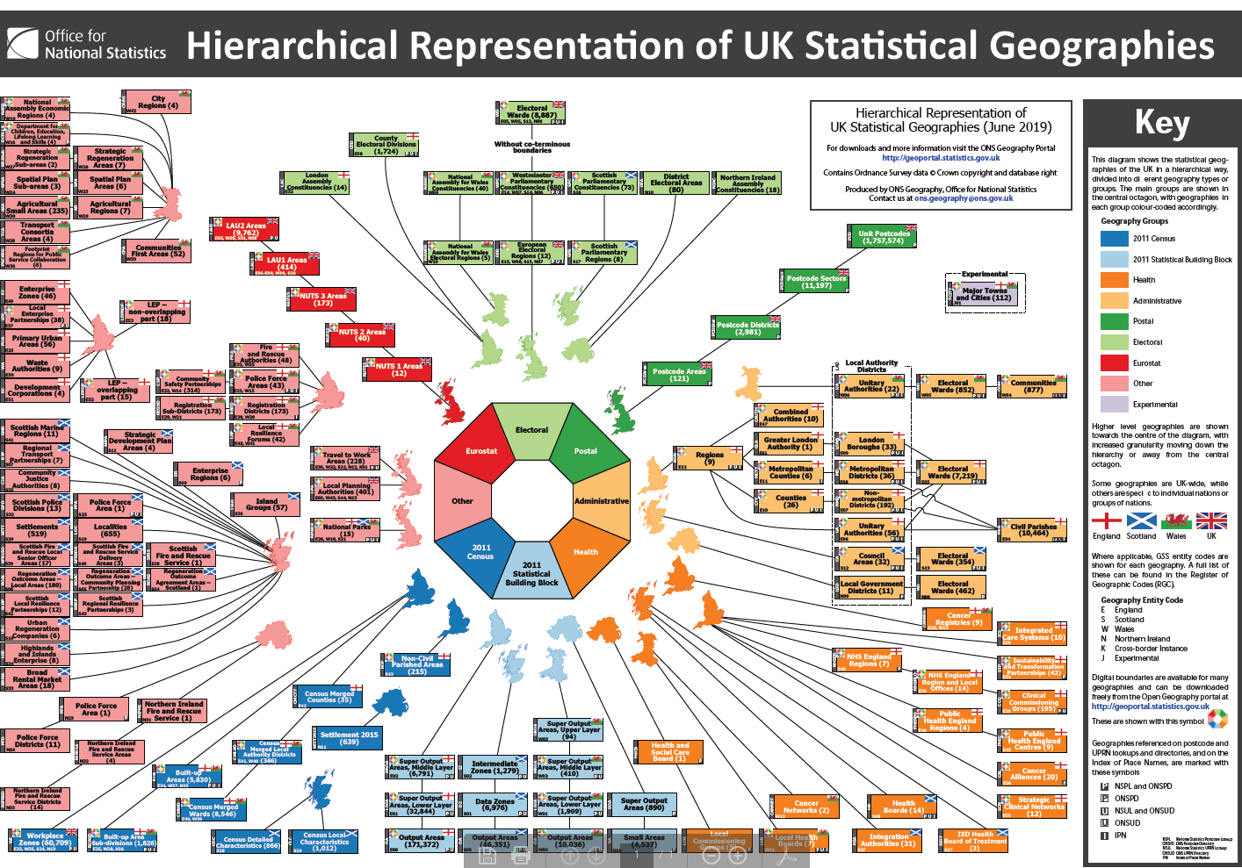
Geodata is giving policy-makers more data… for more areas
Theme: better geodata, better policy
Here in the UK,
each place can
be represented
by numerous
different areas
(‘geographies’)
as illustrated…

Slide 8
Geodata is giving policy-makers more data… for more areas
Theme: better geodata, better policy
Here in the UK,
each place can
be represented
by numerous
different areas
(‘geographies’)
as illustrated…
The key point
is that different
answers are
produced from
analyses of the
same data but
using different
sets of areas

Slide 9
Growing policy need for data using ‘functional’ areas like LMAs…
LMAs (labour market areas, such as TTWAs in the UK) are largely ‘self-contained’ areas in terms of commuting flows: their boundaries are defined so that they contain both the homes and workplaces of most of the local workforce

Slide 10
Growing policy need for data using ‘functional’ areas like LMAs…
LMAs (labour market areas, such as TTWAs in the UK) are largely ‘self-contained’ areas in terms of commuting flows: their boundaries are defined so that they contain both the homes and workplaces of most of the local workforce
Many countries and international bodies use LMAs for research and delivery of policies on (un)employment, industrial districts, transport and mobility etc

Slide 11
Growing policy need for data using ‘functional’ areas like LMAs…
LMAs (labour market areas, such as TTWAs in the UK) are largely ‘self-contained’ areas in terms of commuting flows: their boundaries are defined so that they contain both the homes and workplaces of most of the local workforce
Many countries and international bodies use LMAs for research and delivery of policies on (un)employment, industrial districts, transport and mobility etc
LMAs are superior to administrative areas because of the areas’ comparability due to being defined by consistently analysing updated commuting data with robust methods applied transparently in as much DETAIL as possible
LMAs can thus meet criteria of European Parliament & Council (Reg. 1059/2003): “Non-administrative units must reflect economic, social, historical, cultural, geographical or environmental circumstances” … “Comparability of regional statistics requires … “Objective criteria for the definition of regions”

Slide 12
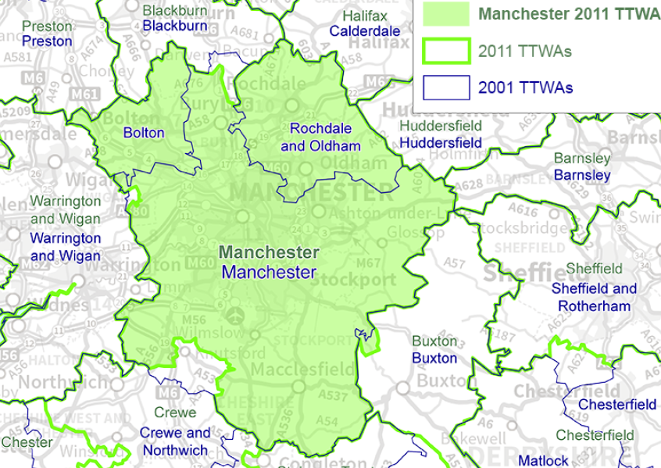
LMA definitions need updating as labour markets transform
Key changes eroding the traditional
‘working week’ model of local LMAs
More low pay part-time working
Changing work form (eg. web-based)
Home-working (often part weeks)
Fewer commuting trips per week
More high paid workers, who can
afford long commutes
More two-professional households,
unable to both work locally
Amid the increasingly diverse commuting flows, growing average commuting distance leads to fewer TTWAs (eg ‘loss’ of Bolton TTWA near to Manchester)
BUT due to ‘friction of distance’ localised LMA still reflect majority behaviour

Slide 13
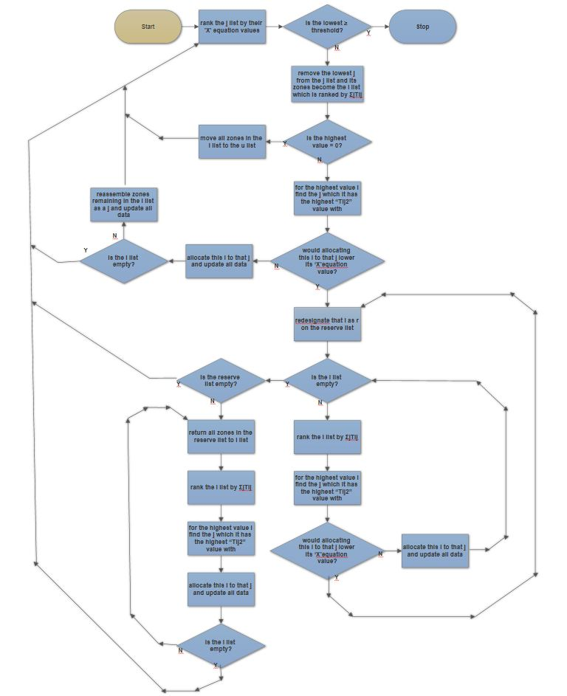
Meeting the LMA definition challenge
This flow chart is of the CURDS-ONS "TTWA" method which is the result of repeated innovation over several decades of development
Its algorithm implements the concept of the local labour market while meeting the policy requirement that the process must be robustly objective (and so replicable)
The transferability of the procedure has been proven by successful applications to data for different times and strongly differing countries around the world

Slide 14
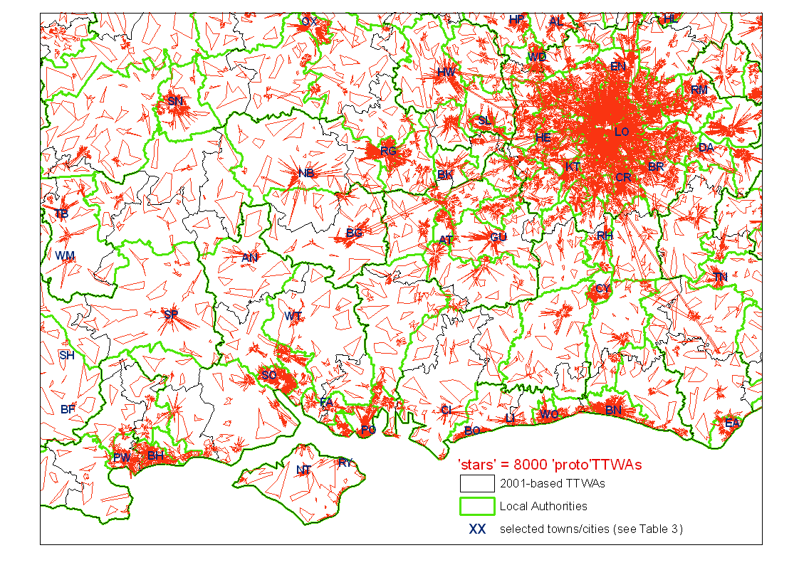
8000 ‘proto’TTWAs (commuting clusters, groups of neighbourhoods)

Slide 15
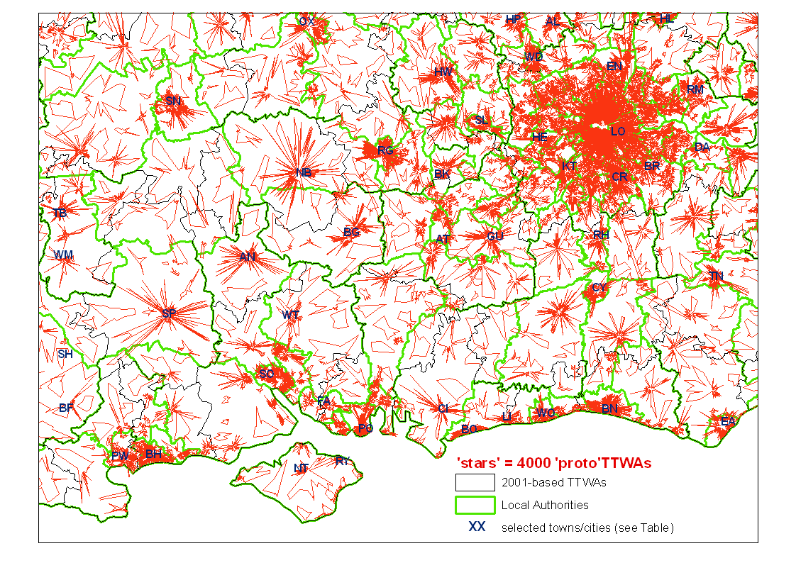
4000 ‘proto’TTWAs

Slide 16
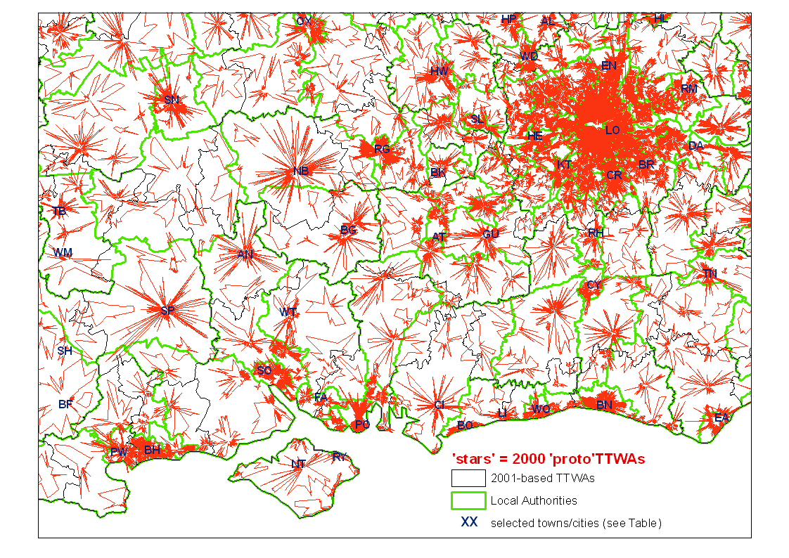
2000 ‘proto’TTWAs

Slide 17

1000 ‘proto’TTWAs

Slide 18
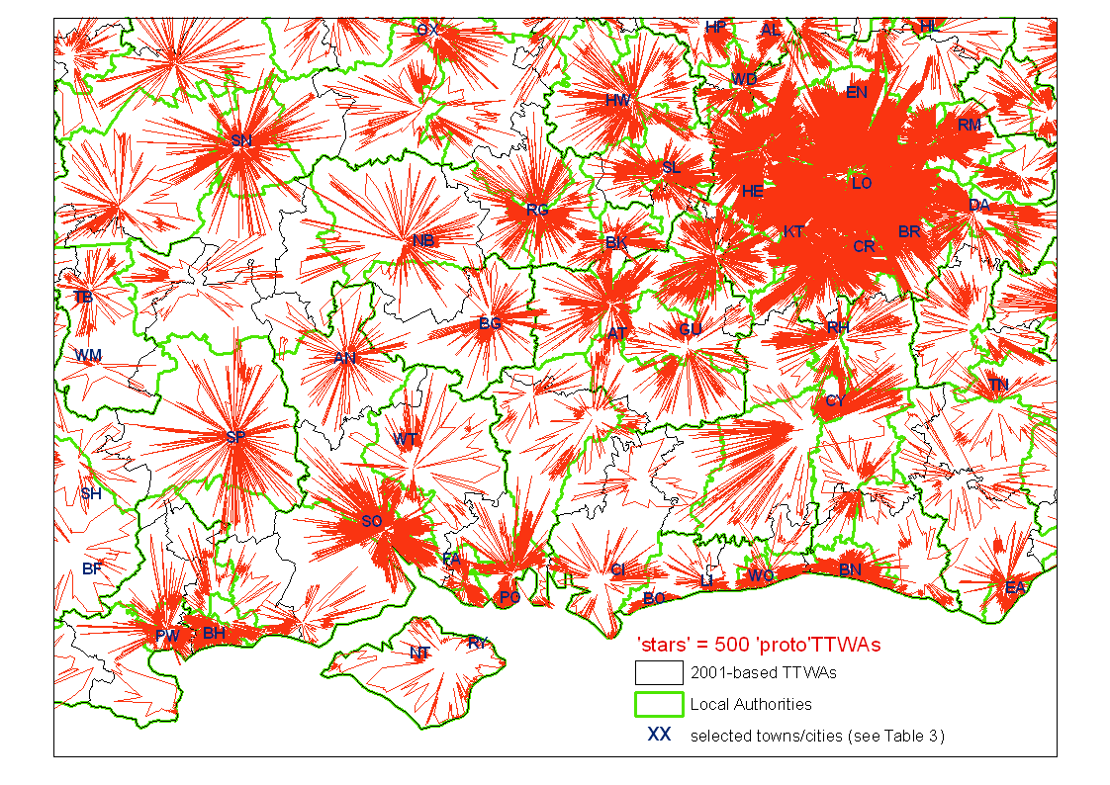
500 ‘proto’TTWAs

Slide 19
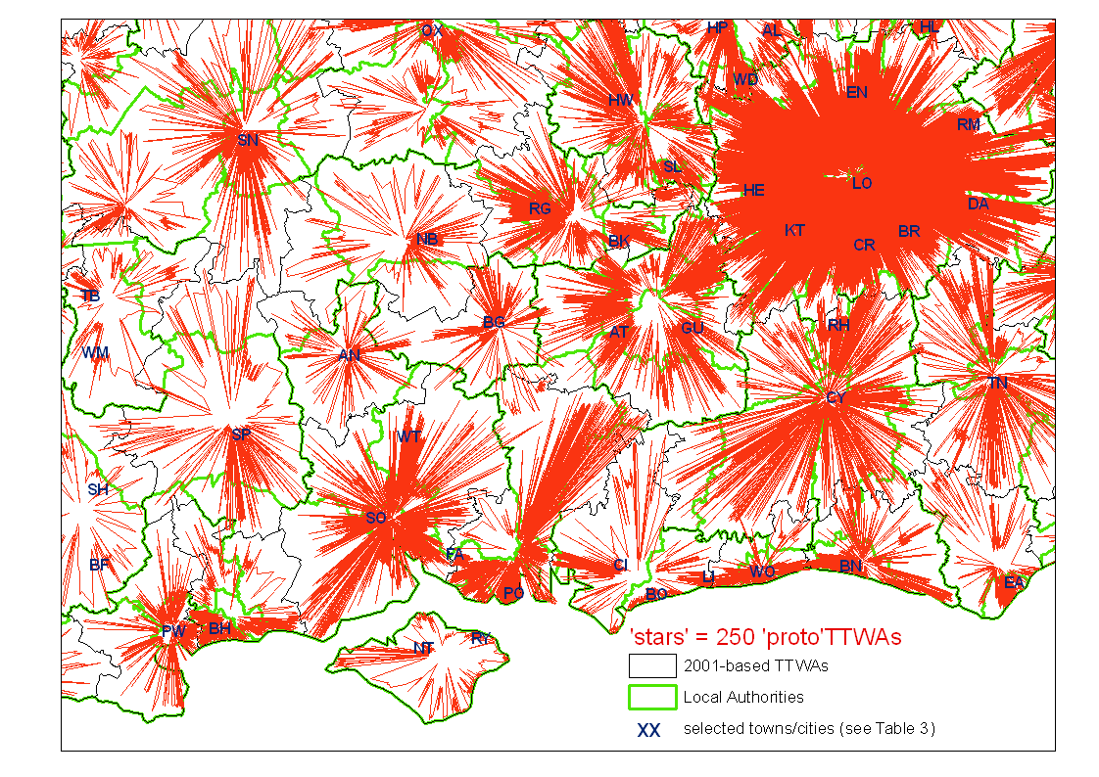
250 ‘proto’TTWAs

Slide 20
Key messages from 40 years of creating the internationally- adopted method to define LMAs for statistics and policy
The best method results from exposure to policy needs and repeated innovation

Slide 21
Key messages from 40 years of creating the internationally- adopted method to define LMAs for statistics and policy
The best method results from exposure to policy needs and repeated innovation
Successive collaborative projects between the National Statistical Institute ONS (and predecessors) and academics has built trust and ‘collective memory’
ONS ensure statistical rigour and provide policy sensitivity
Academics bring learning from sustained engagement in debates on methods

Slide 22
Key messages from 40 years of creating the internationally- adopted method to define LMAs for statistics and policy
The best method results from exposure to policy needs and repeated innovation
Successive collaborative projects between the National Statistical Institute ONS (and predecessors) and academics has built trust and ‘collective memory’
ONS ensure statistical rigour and provide policy sensitivity
Academics bring learning from sustained engagement in debates on methods
The result is a flexible and partially self-optimising algorithm which Eurostat identified as ‘best practice’ for defining policy-relevant LMAs which due to its transferability makes possible ‘harmonised’ LMA definitions internationally

